Slide 1
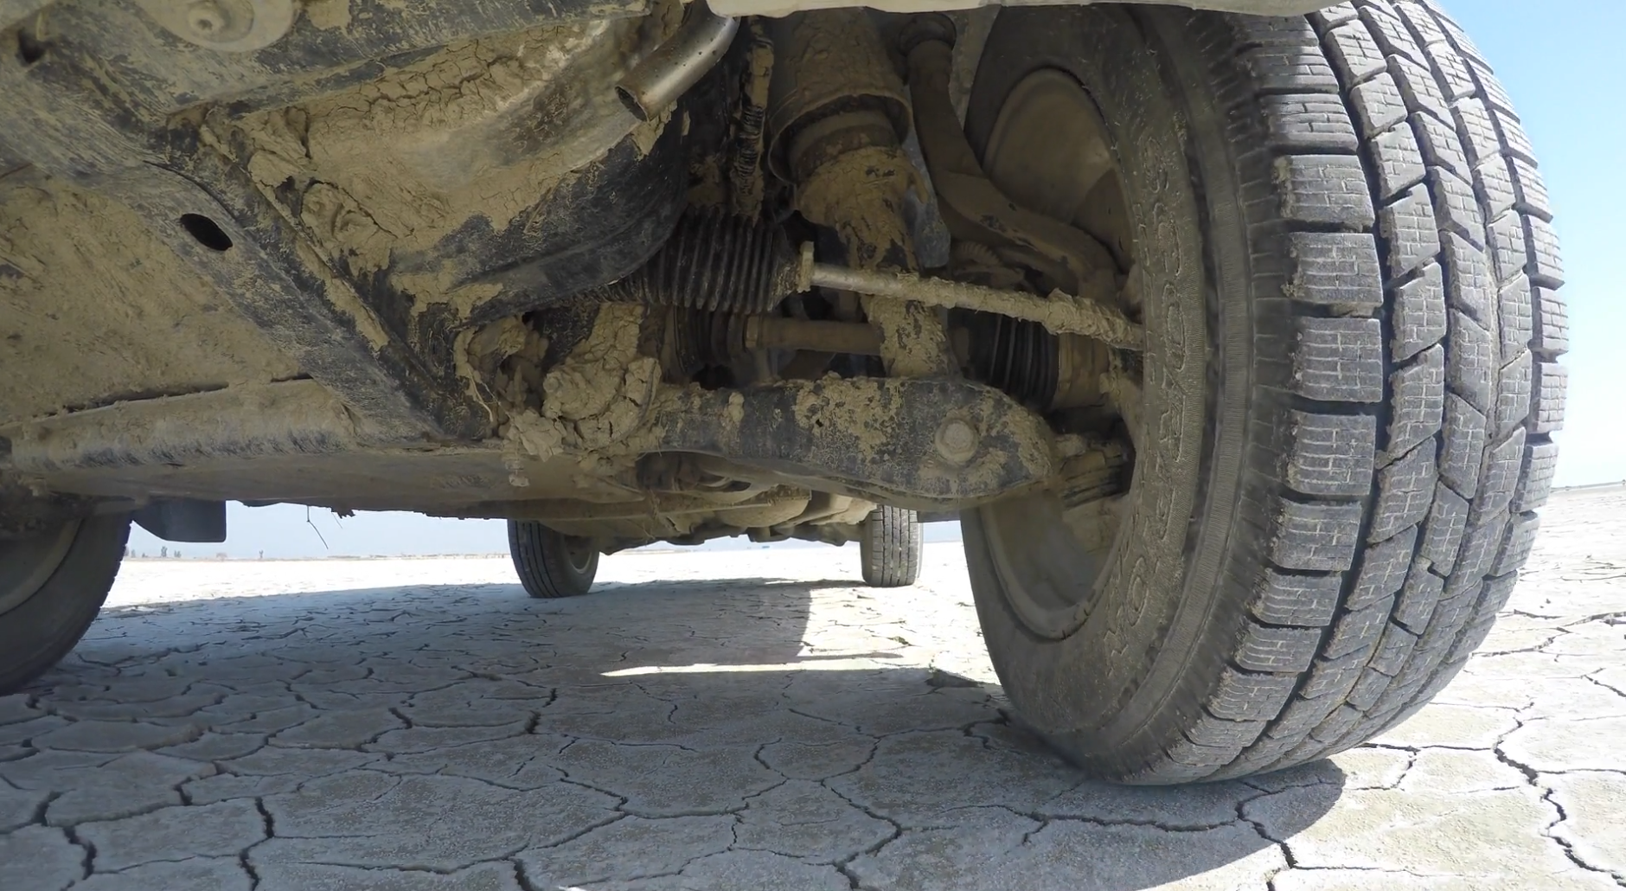
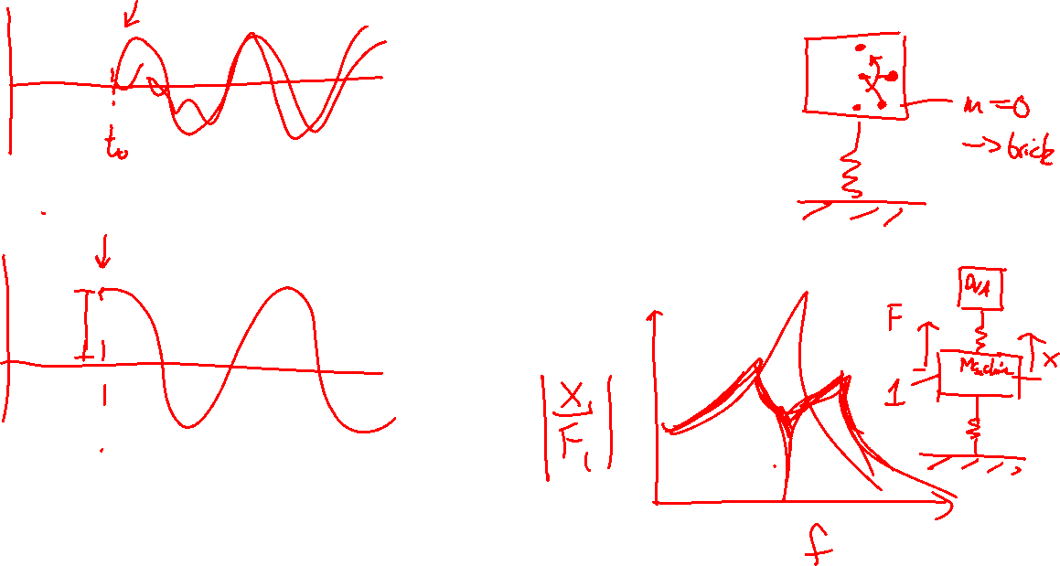
Vibration isolation
Practical considerations and measurements
Tyler Dare

Slide 2
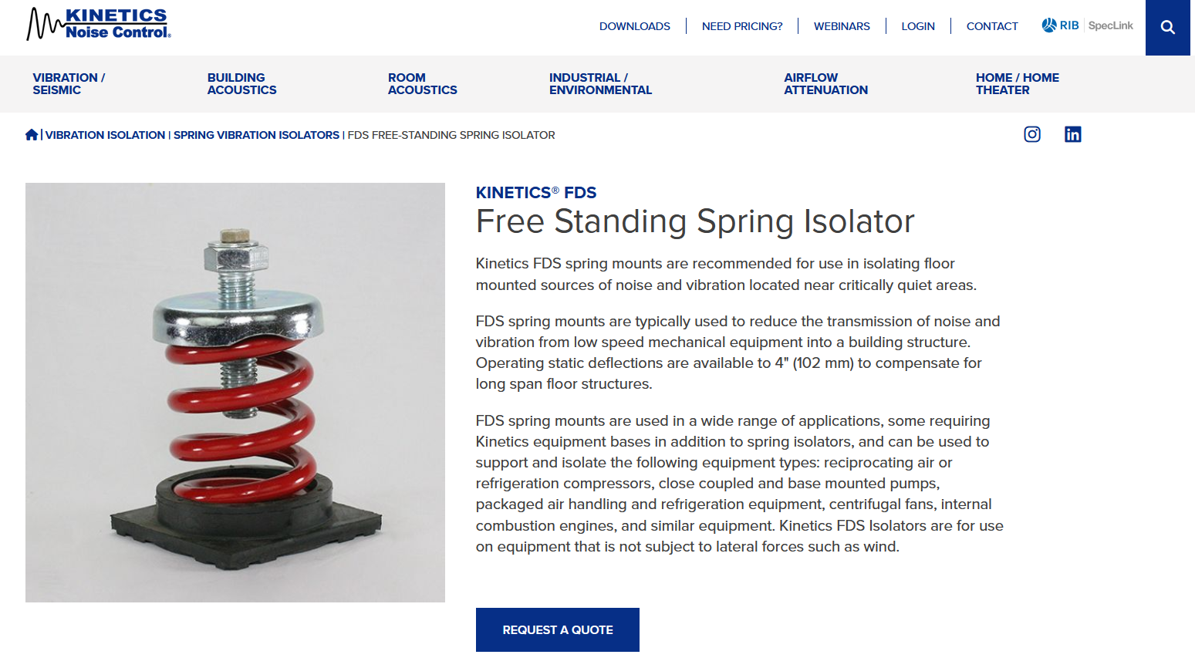
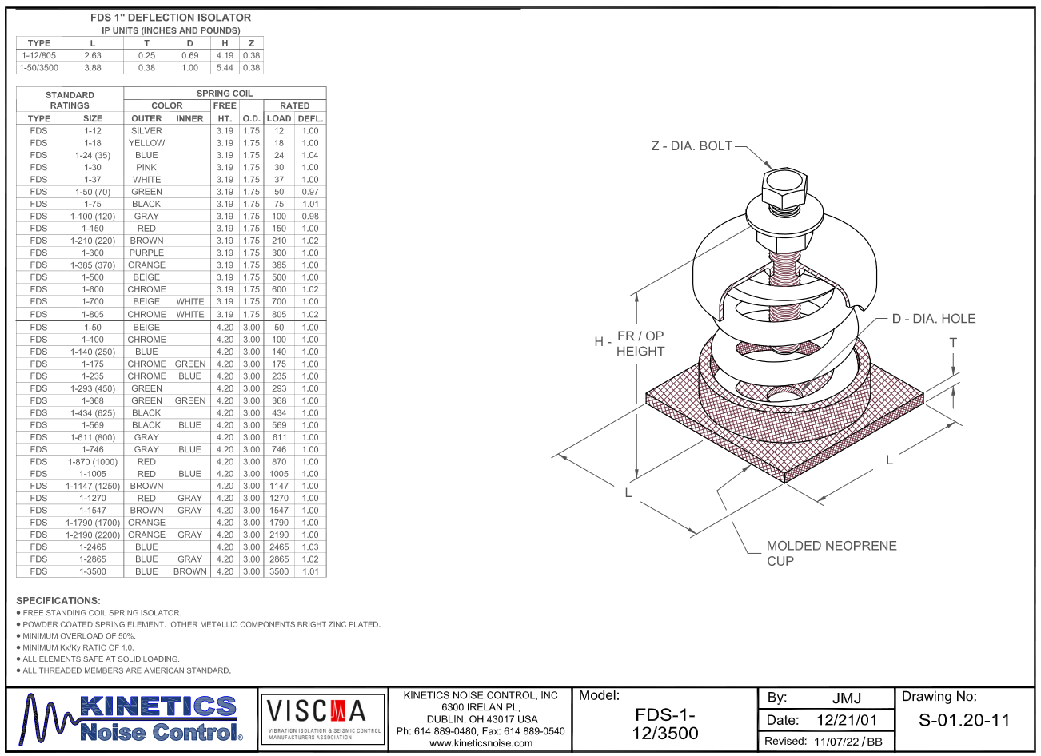
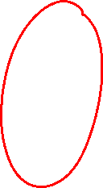
Specifying isolators
Spring elements often specified with maximum load and deflection.
From Kinetics Noise Control

Slide 3
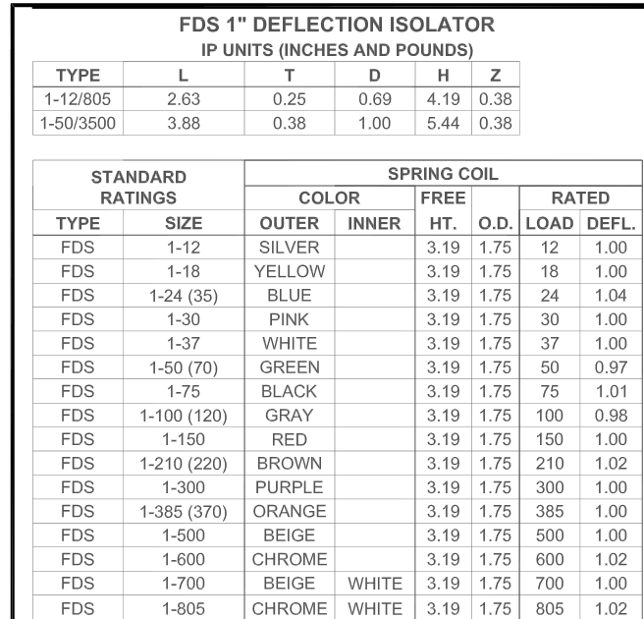
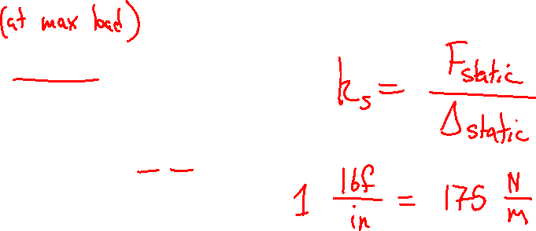
Specifying isolators
Spring elements often specified with maximum load and deflection.
From Kinetics Noise Control

Slide 4
Types of isolators
Actual response of a given material depends on geometry, configuration, machine’s mass, etc.
But different types of isolators tend to be used more often in different frequency ranges
Rubber and elastomers
Cork and felt pads
Air springs
Metal springs
Operating frequency
1 Hz
10 Hz
100 Hz
Maximum deflection
250 mm
2.5 mm
0.025 mm

Slide 5
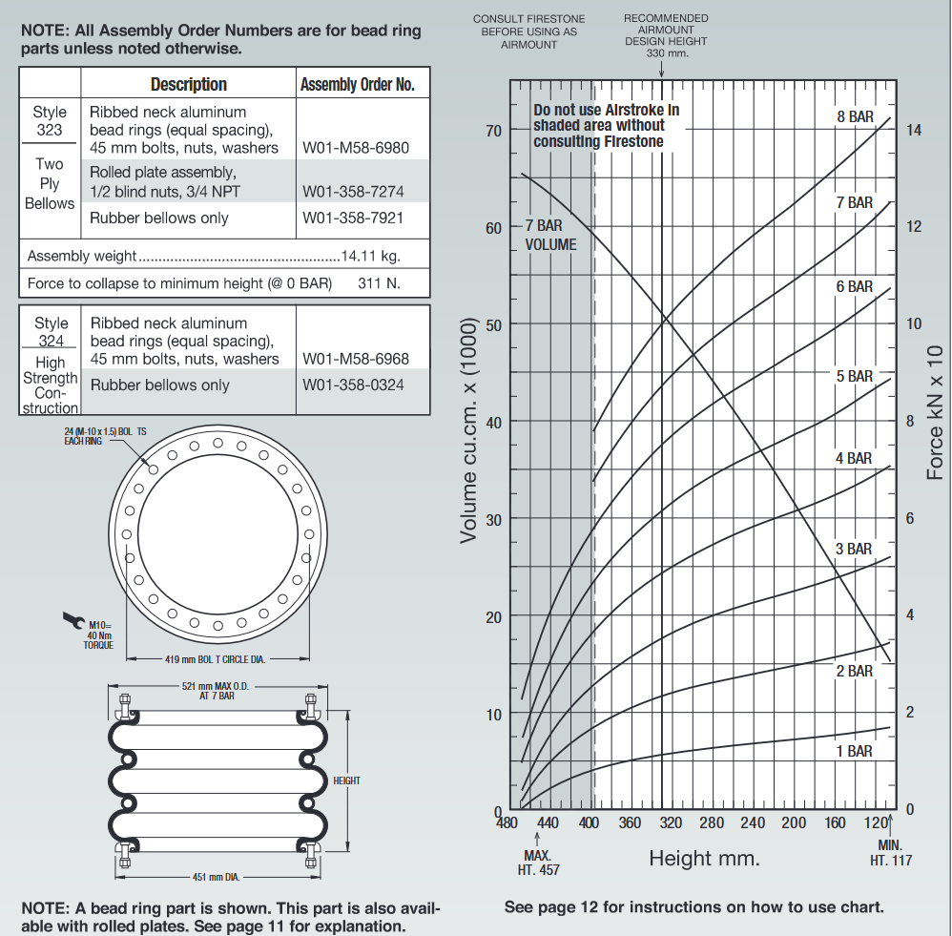
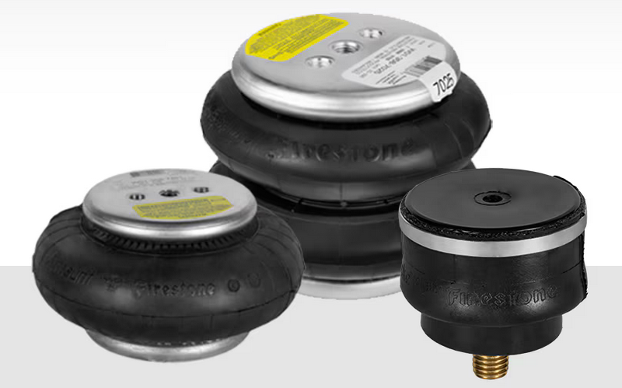
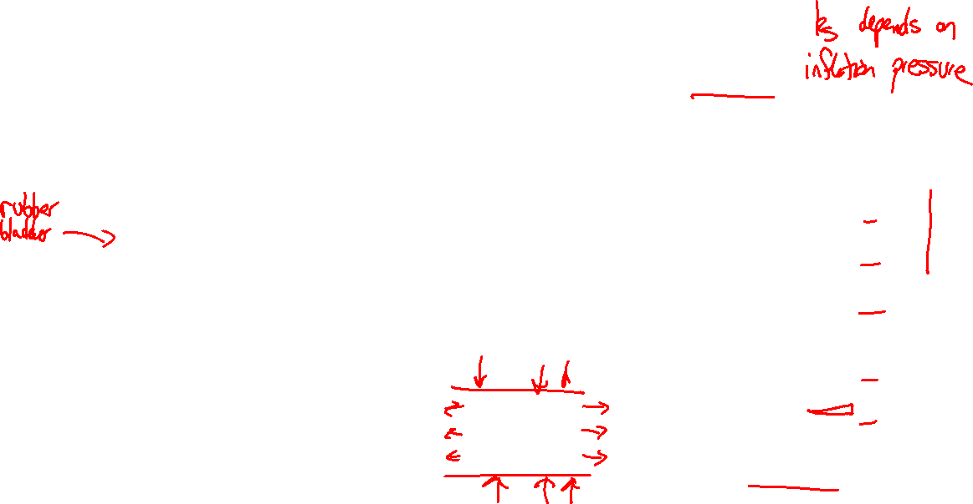
Air springs
Air springs can be used at very low frequencies, down to 1 Hz or less.
From Firestone Airride

Slide 6
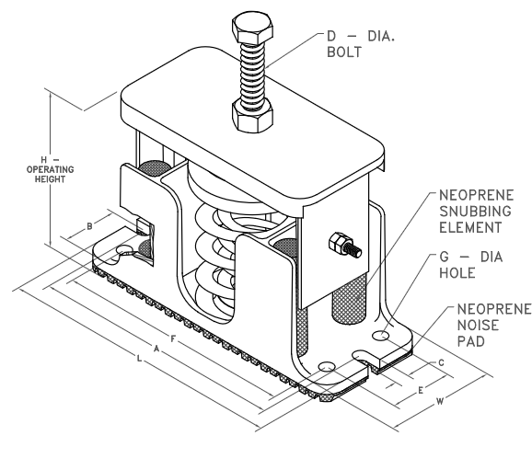
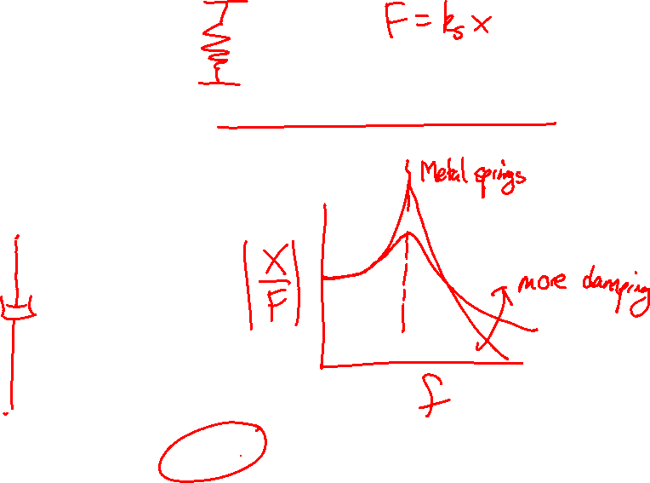
Metal springs
Metal springs have very low internal damping, so either avoid resonance or include a damping element in parallel.
From Kinetics Noise Control

Slide 7
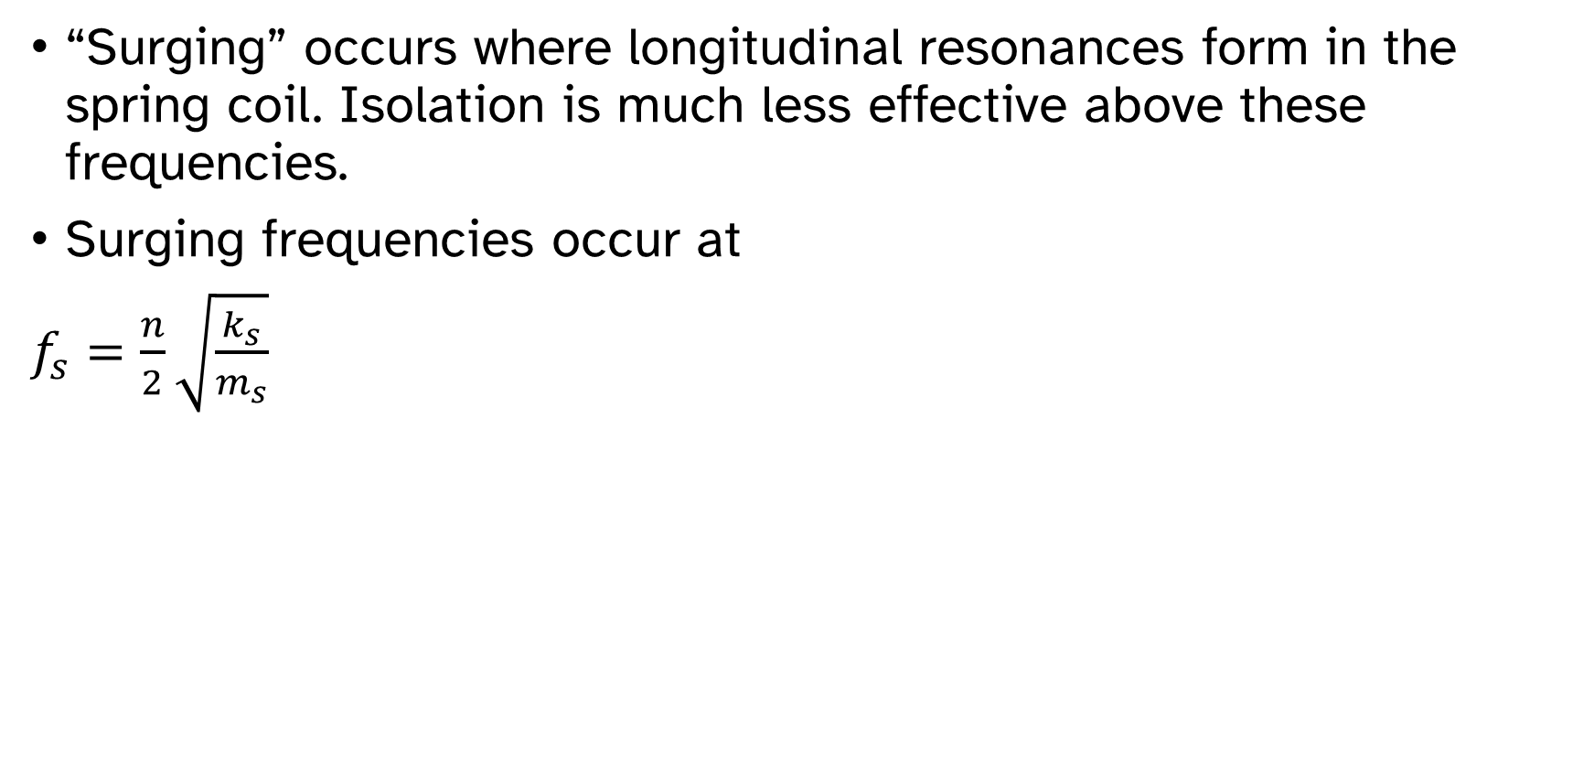
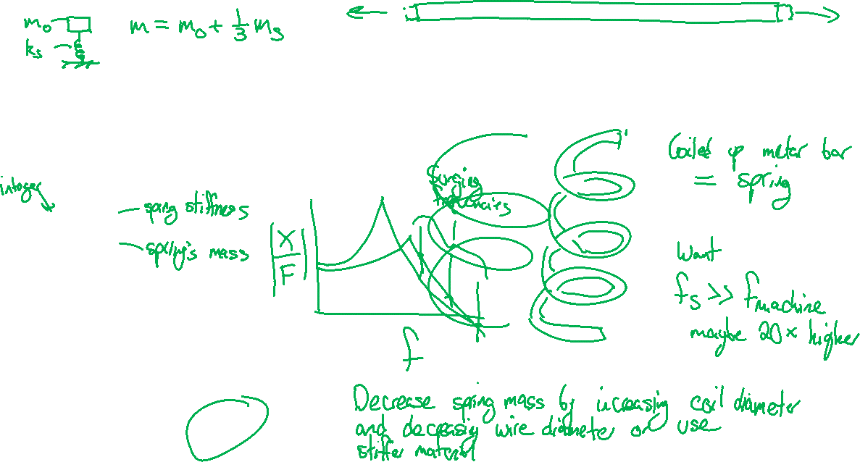
Surging in springs
“Surging” occurs where longitudinal resonances form in the spring coil. Isolation is much less effective above these frequencies.
Surging frequencies occur at
$f_{s}=\frac{n}{2}\sqrt{\frac{k_{s}}{m_{s}}}$
From Kinetics Noise Control

Slide 8
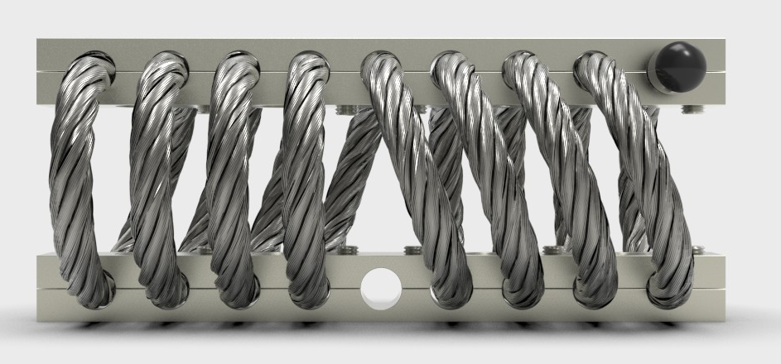
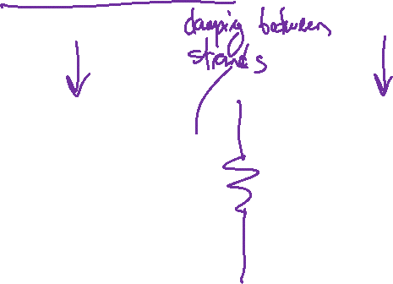
Wire rope isolators
Coiled wire ropes act as springs and also provide damping due to friction between strands.
Nonlinear effects can occur, so make sure to test after installation.
From Isolation Dynamics Corp.

Slide 9
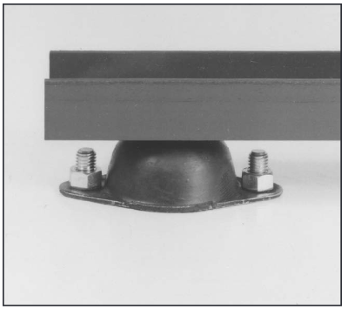
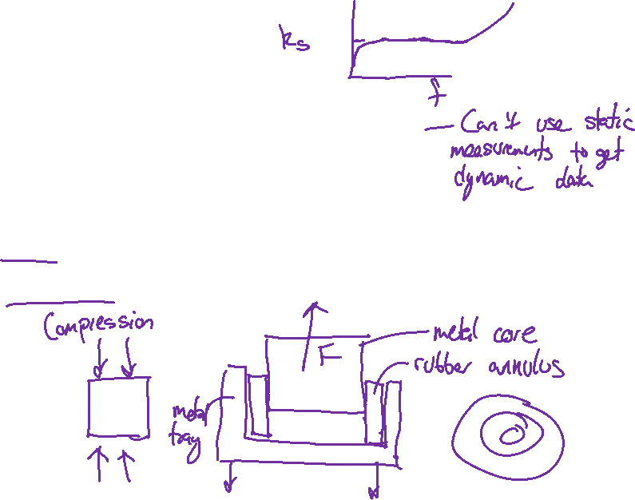
Rubber isolators
Dynamic stiffness can be 1.3–1.8 times static stiffness, so dynamic data is needed for isolation predictions.
Damping depends on specific type of rubber and chemistry.
Different stiffness in shear vs. compression
Generally not used in tension due to fatigue damage
From Kinetics Noise Control

Slide 10
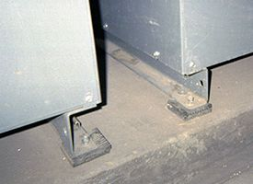
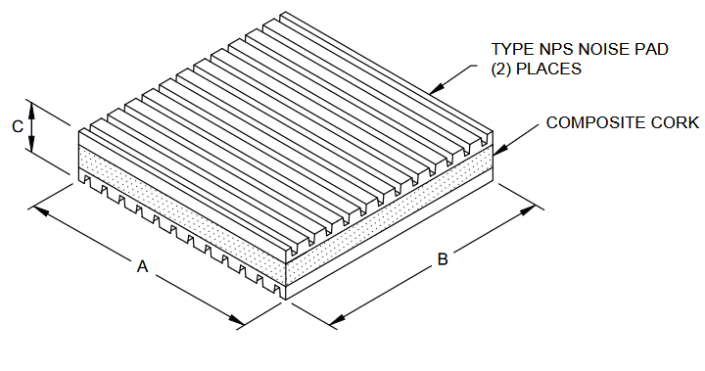
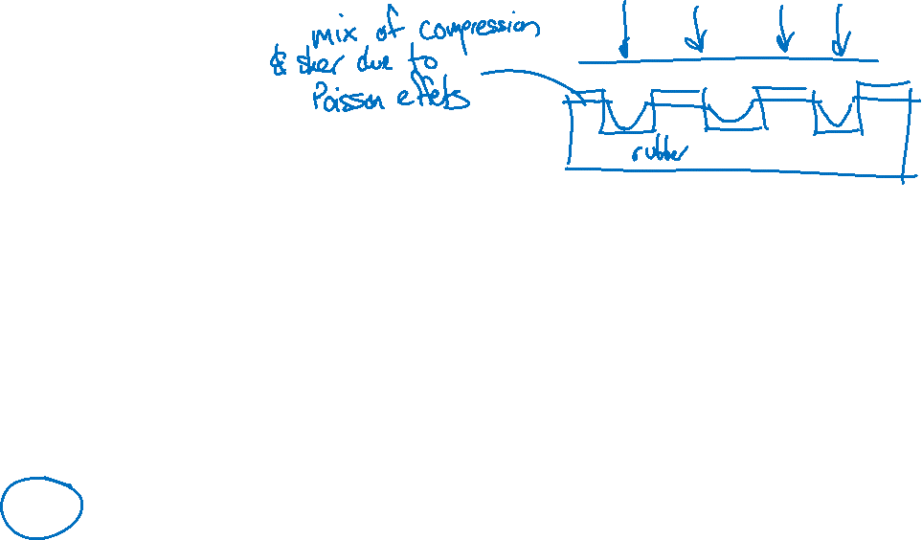
Pads
Isolation pads are easy to install.
Stiffness depends on material, thickness, and geometry.
Cork and felt can have stiffness dependent on frequency and preload.
From Kinetics Noise Control
From Kinetics Noise Control

Slide 11
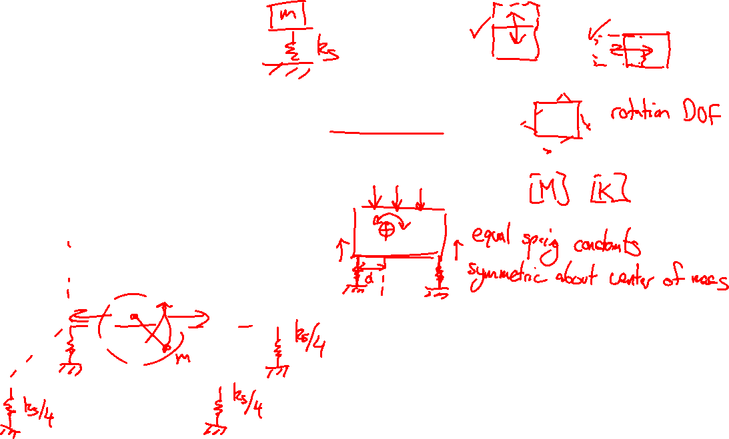
Four-isolator systems
6 DOF motion is possible for rigid body
Imbalanced mass load will force horizontal and vertical directions equally.
Need to consider lateral stiffness of isolators.

Slide 12
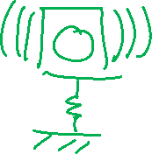
High-frequency response
At high frequencies, the resonances of the structure being isolated will start to matter.
The vibrating structure will generate sound, even though force is not being transmitted to the foundation.
Isolation is generally ineffective at reducing audible frequencies.

Slide 13

Designing a mounting system
A machine in a factory is shaking the floor and disrupting other work. Design an isolation mount to reduce the vibration of the floor.
Machine
Machine
Mount

Slide 14
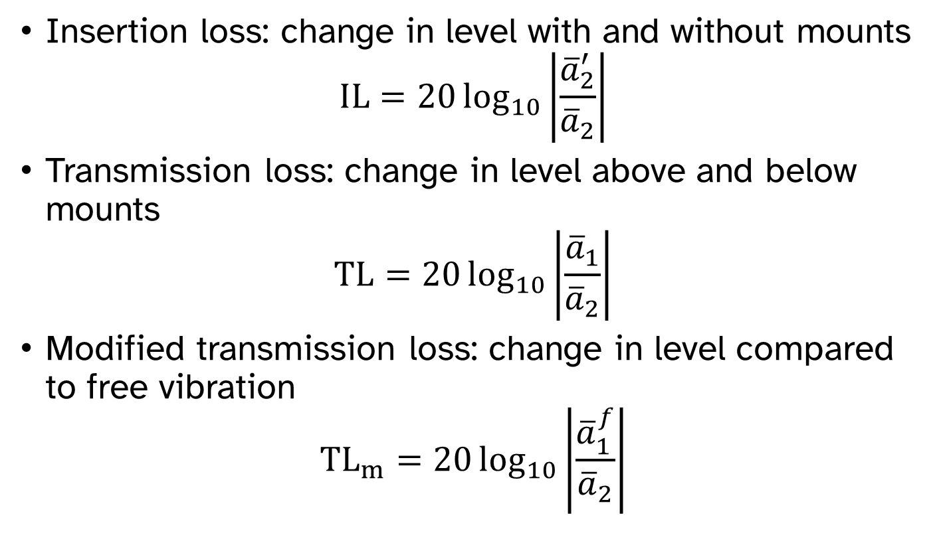
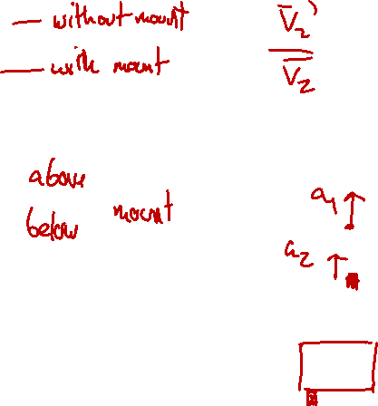
Measuring isolation performance
Insertion loss: change in level with and without mounts
$$IL=20\log_{10}\left|\frac{{\overline{a}}_{2}^{′}}{{\overline{a}}_{2}}\right|$$
Transmission loss: change in level above and below mounts
$$TL=20\log_{10}\left|\frac{{\overline{a}}_{1}}{{\overline{a}}_{2}}\right|$$
Modified transmission loss: change in level compared to free vibration
$${TL}_{m}=20\log_{10}\left|\frac{{\overline{a}}_{1}^{f}}{{\overline{a}}_{2}}\right|$$
Machine
Mount

Slide 15


Measuring vibration
Accelerometers output voltage proportional to acceleration.
Piezoelectric accelerometers are the most common for industrial and scientific applications.
Accelerometers from PCB Piezotronics

Slide 16
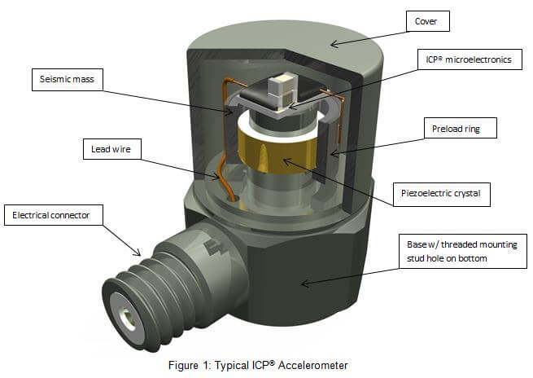
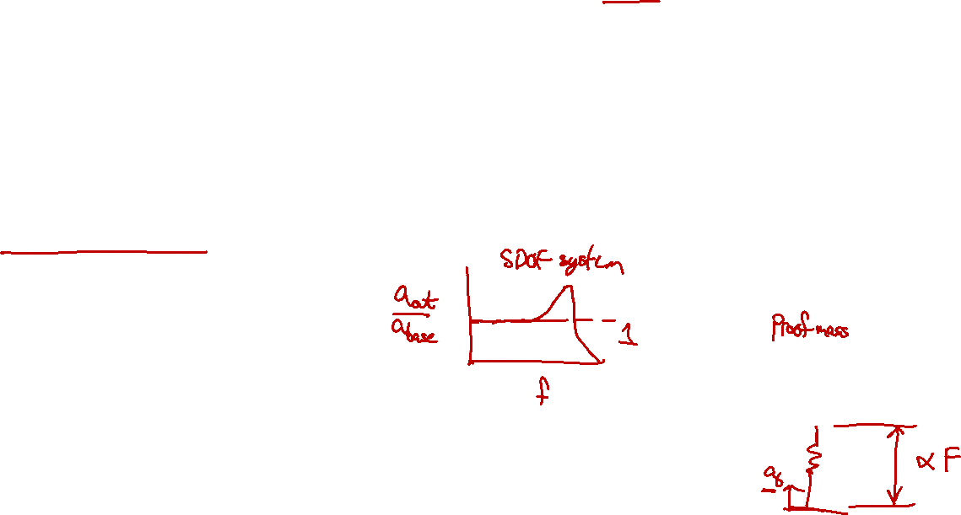
Measuring vibration
Piezoelectric crystals produce a small electrical charge proportional to pressure.
Integrated circuitry amplifies the signal and converts it to a voltage usable by the data acquisition system.
The DC component (constant acceleration) is usually (but not always) filtered out.
Diagram from PCB Piezotronics
Mass
Crystal
Amp

Slide 17
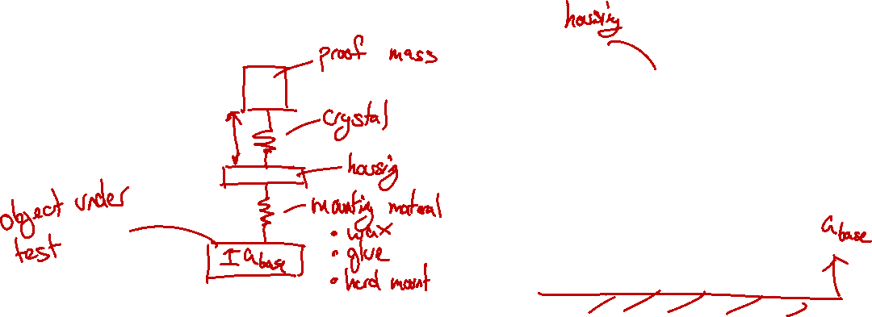
Accelerometer response
The accelerometer system acts as a multi-DOF oscillator. The output is related to the compression of the crystal.
Mass
Crystal
Amp

Slide 18
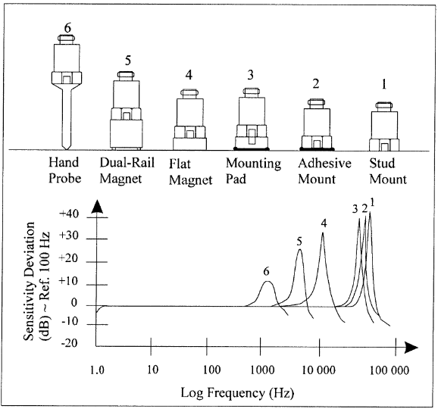
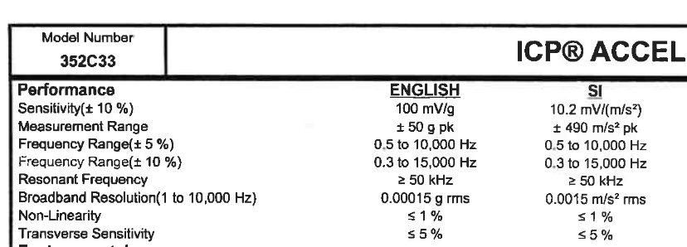
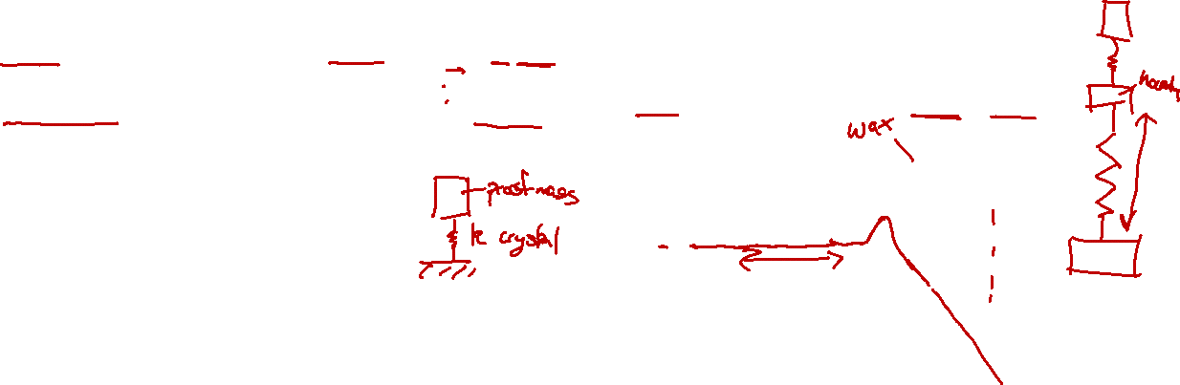
Accelerometer response
Diagram from PCB Piezotronics

Slide 19
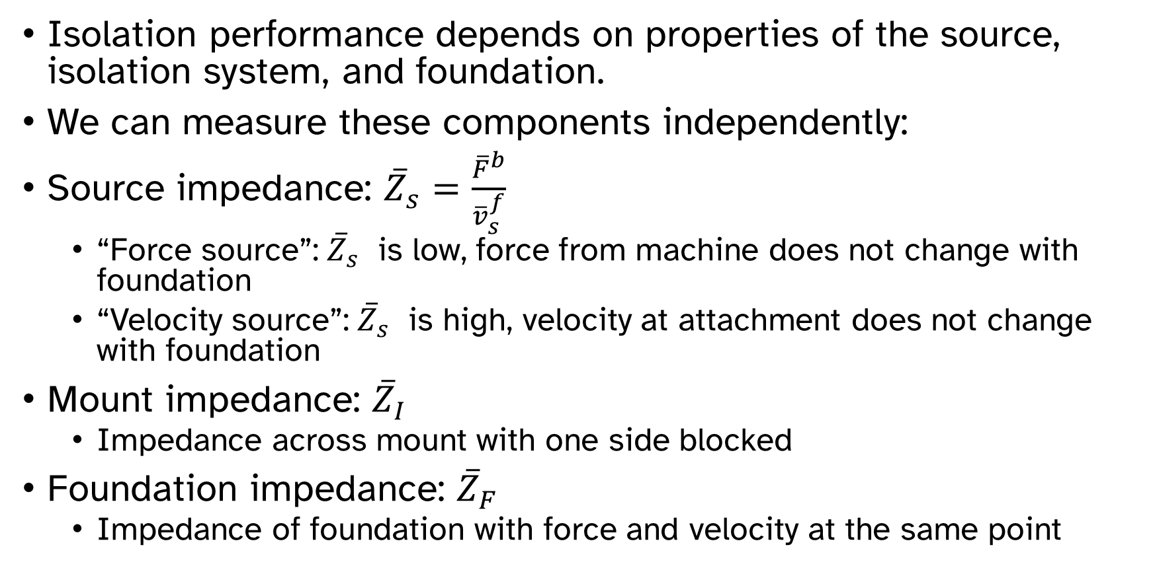
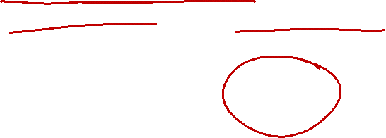
Predicting isolation performance
Isolation performance depends on properties of the source, isolation system, and foundation.
We can measure these components independently:
Source impedance: ${\overline{Z}}_{s}=\frac{{\overline{F}}^{b}}{{\overline{v}}_{s}^{f}}$
“Force source”: ${\overline{Z}}_{s}$ is low, force from machine does not change with foundation
“Velocity source”: ${\overline{Z}}_{s}$ is high, velocity at attachment does not change with foundation
Mount impedance: ${\overline{Z}}_{I}$
Impedance across mount with one side blocked
Foundation impedance: ${\overline{Z}}_{F}$
Impedance of foundation with force and velocity at the same point

Slide 20
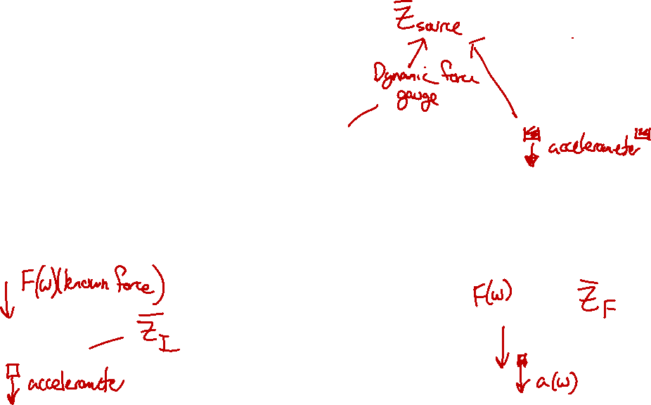
Predicting isolation performance
Test 1A: Blocked force
Test 1B: Free velocity
Machine
Machine
Machine
Mount
Fixed foundation
Test 2: Mount impedance
Test 3: Foundation impedance
Mount

Slide 21
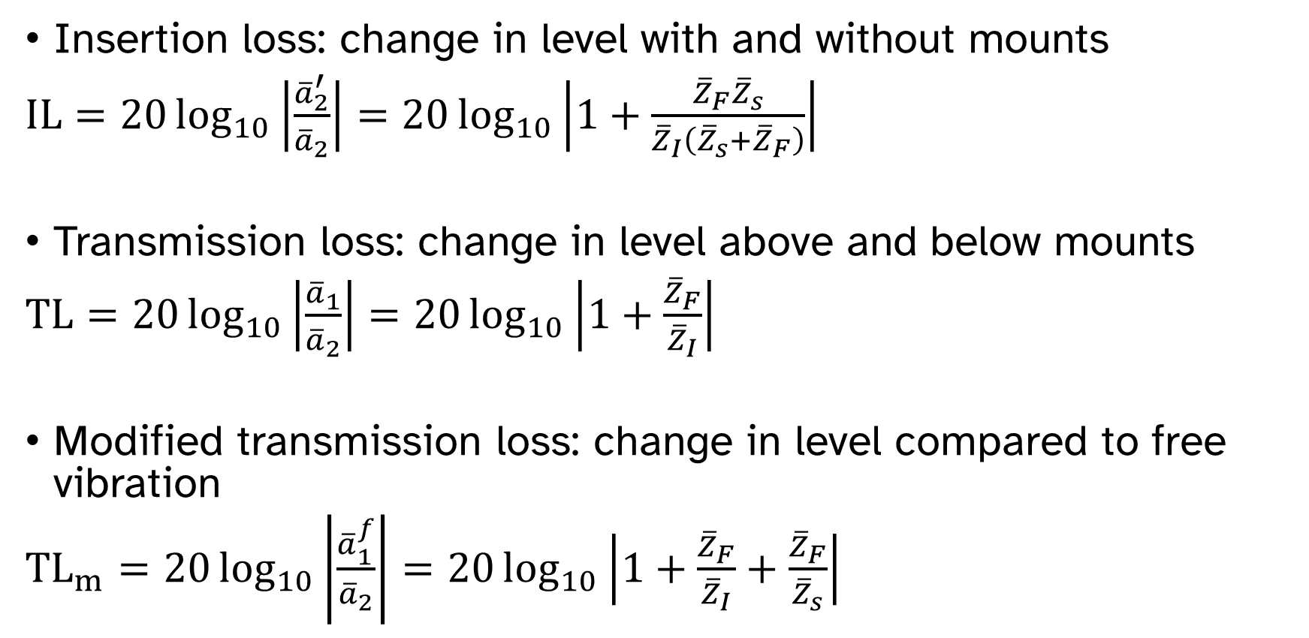
Predicting isolation performance
Insertion loss: change in level with and without mounts
$IL=20\log_{10}\left|\frac{{\overline{a}}_{2}^{′}}{{\overline{a}}_{2}}\right|=20\log_{10}\left|1+\frac{{\overline{Z}}_{F}{\overline{Z}}_{s}}{{\overline{Z}}_{I}\left({\overline{Z}}_{s}+{\overline{Z}}_{F}\right)}\right|$
Transmission loss: change in level above and below mounts
$TL=20\log_{10}\left|\frac{{\overline{a}}_{1}}{{\overline{a}}_{2}}\right|=20\log_{10}\left|1+\frac{{\overline{Z}}_{F}}{{\overline{Z}}_{I}}\right|$
Modified transmission loss: change in level compared to free vibration
${TL}_{m}=20\log_{10}\left|\frac{{\overline{a}}_{1}^{f}}{{\overline{a}}_{2}}\right|=20\log_{10}\left|1+\frac{{\overline{Z}}_{F}}{{\overline{Z}}_{I}}+\frac{{\overline{Z}}_{F}}{{\overline{Z}}_{s}}\right|$

Slide 22
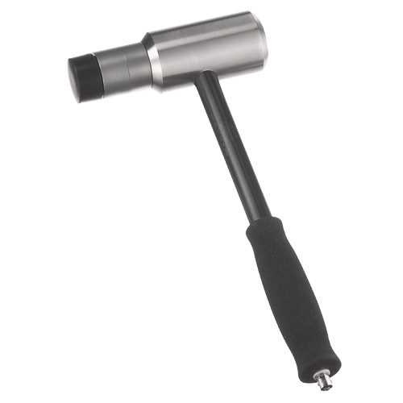
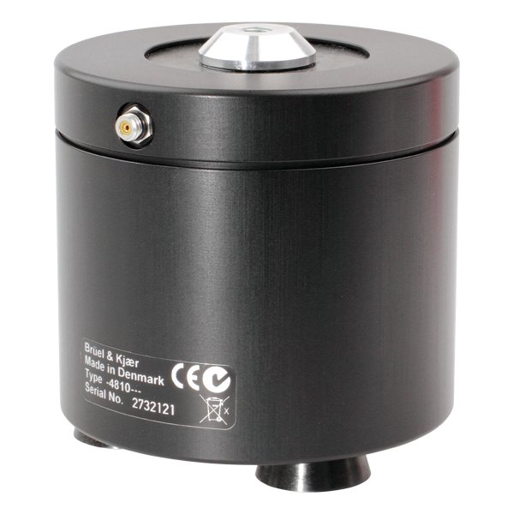
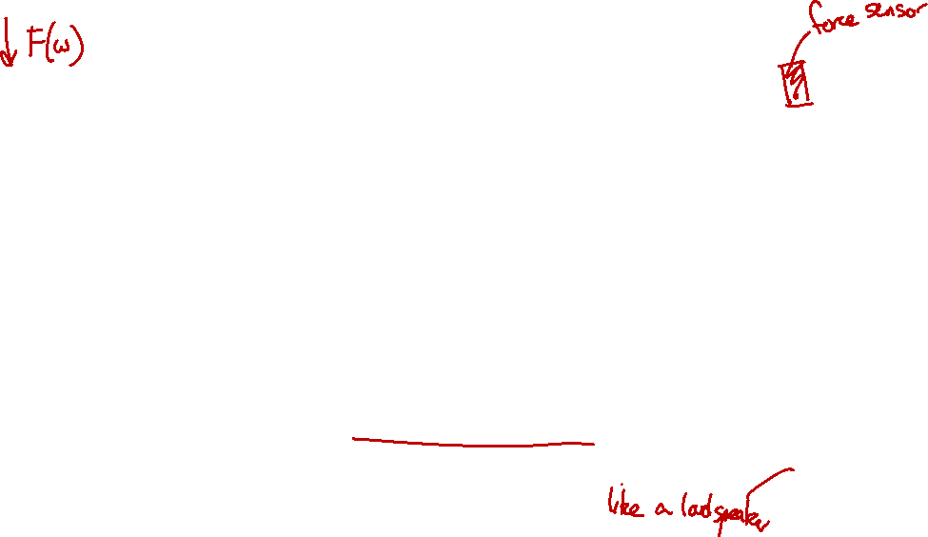
Applying known forces: shakers and instrumented hammers
An instrumented hammer is more useful when:
You want to learn about the free response of a structure
The structure is expected to have a linear response in the frequency and amplitude range of interest
The structure does not permit easy or fast mounting of a shaker
A shaker is more useful when:
You want to learn about the response due to a particular load
You suspect the structure has a nonlinear response
You want to learn about the change in response over time
Kistler.com

Slide 23
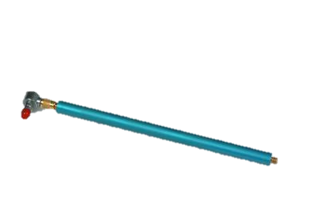
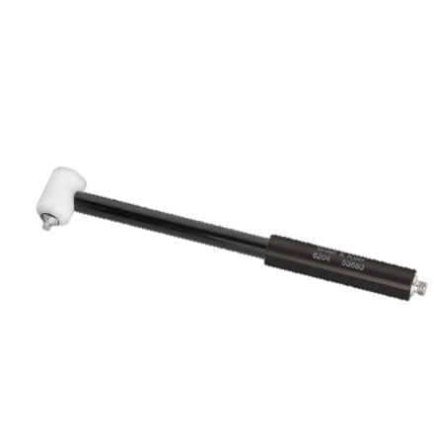
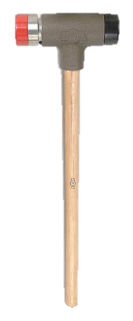
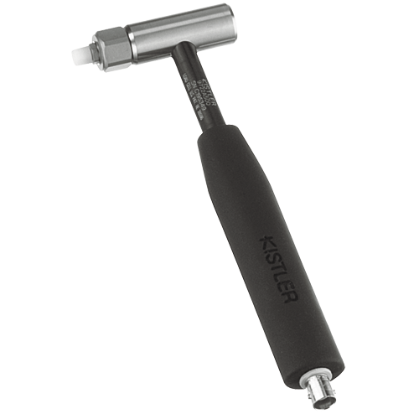

Selecting the hammer size and tip material is crucial.
PCB.com
Kistler.com
Kistler.com
bksv.com
PCB.com

Slide 24

Selecting the hammer size and tip material is crucial.
More energy
Higher frequency range

Slide 25
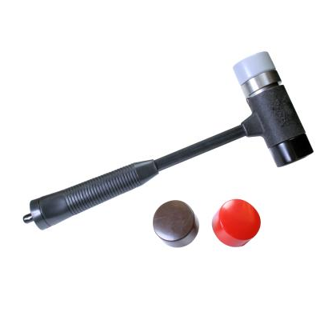
Selecting the hammer size and tip material is crucial.
Tips of varying hardness
PCB.com

Slide 26

Choosing a hammer tip

Slide 27
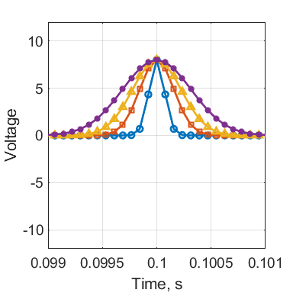
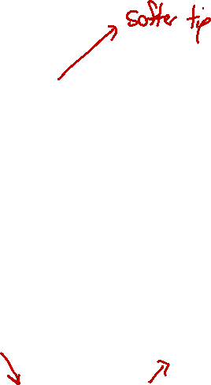
Choosing a hammer tip
Harder tip
Harder tip

Slide 28


Double hits cause a scalloped appearance in the frequency domain.
$$Δt$$
$$f=\frac{1}{Δt}$$

Slide 29
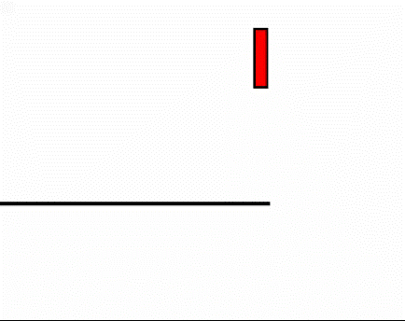
Double hits cause a scalloped appearance in the frequency domain.
Hammer
Moderately damped structure

Slide 30
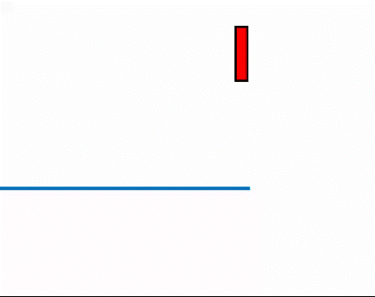
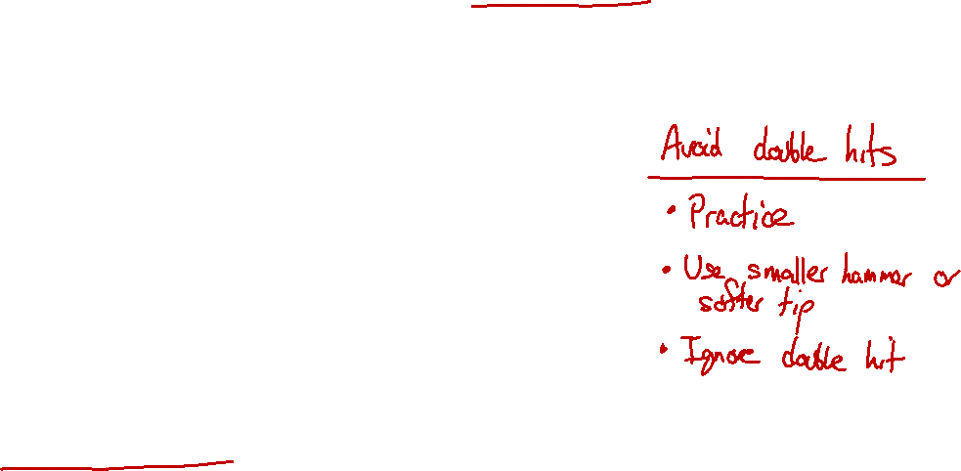
Structures with low damping can make double hits difficult to avoid.
Hammer
Lightly damped structure

Slide 31
Structures with low damping can make double hits difficult to avoid.

Slide 32
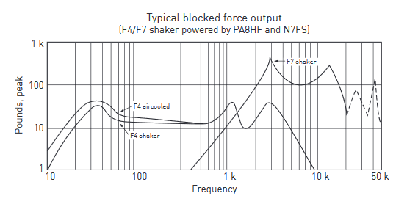


Shaker selection depends on size and frequency range.
Wilcoxon F4/F7
wilcoxon.com

Slide 33

Shaker selection depends on size and frequency range.
Brüel & Kjær Type 4810
bksv.com

Slide 34



Mount shakers with a stinger, and monitor applied force with force gauge or impedance head.
Ward, Frederick, “Comparing steady state and impulse test methods to measure the damping of composites applied to homogeneous substrates”, Proc. INTER-NOISE 2018.
Zehme, John, “Evaluating Damping Treatments using Radiated Sound Power normalized by Input Mechanical Power”, Proc. INTER-NOISE 2018.

Slide 35
Choosing shaker excitation signal
Gaussian random noise
Should be your go-to signal for most measurements.
Easy to get plenty of averages.
Energy input depends on frequency range. Filter to get more energy in a certain band.
Swept sine wave
Takes longer to get enough averages.
Can get more energy at each frequency.
Easier to detect nonlinearities in the system.
Play-back of previously recorded measurement

